Slide 1

Testing for Category Part | Belayneh Mathewos

Slide 2
Test Plan
1.When retrieving item from shola database
As much as possible to achieve the system that is at least 80% free from non-tolerable errors/defects.
The system should be 80% free from defects
2.When seller upload his/her item
As much as possible to achieve the system that is at least 85% free from non-tolerable errors/defects.
The system should nearly be 85% free from defects

Slide 3
Test case specifications
1.When retrieving item from shola database
Test cases:
If database is empty, what will happen to retrieve items
=>no program crushing happen, but display nothing.
2.When seller upload his/her item
Test cases:
Image posting and retrieval should include all types.?
All fields should be filled – if some field remains empty, will not be uploaded.
- tells the remaining field to the seller to fill it.

Slide 4
Cont.
Item name, description and category -any inputs(alphanumeric)
-If item name, … too large(can database store it?)
Quantity, availability – integer(number) inputs
price – double(number) input

Slide 5
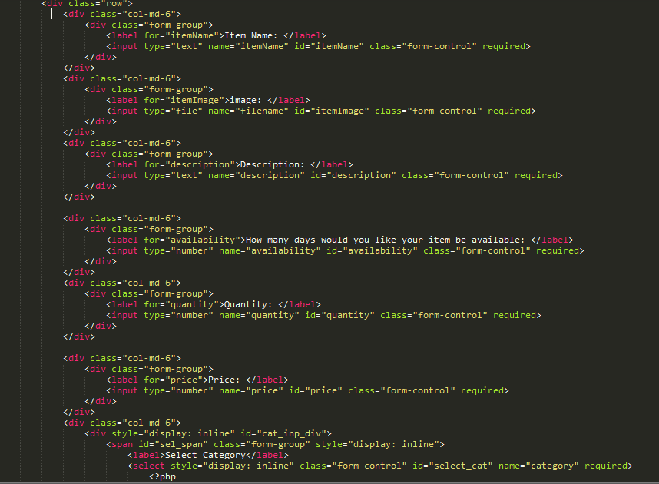
Cont.
Sample code with simple modification.

Slide 6
THE RESULTS IN TABLE FORM
TC No. | Features | Description | Steps to Execute | Test Data/Input / Expected | Successful
1 | Required fields | -Check the required fields by not filling any data | 1. Do not enter any value in the field 2. Click on Post button | -message should be displayed | YES
2 | Required fields | -Check the required fields by not filling at least only one field | 1. Leave only one field empty 2. Click on Post button | --message should be displayed | YES
3 | Required fields: -name, -description, -category | -Check the required fields: -name, -description, -category by filling any input type | 1. Fill name, description, category by any input type with valid values in other required fields 2. Click on Post button | -S6 phone, -smart phone with 4GB ram,.. -Phone | YES

Slide 7
Cont.
4 | Required fields: -quantity, -availability -price | Check the required fields: -quantity, -availability -price by filling any input type | 1. Fil quantity, Availability, Price by any input type with valid values in other required fields 2. Click on Post button | -10 -60 -40000$
5 | Required fields: -Image | Check the required fields: -Image by filling any input type | 1. Fil image by any input type with valid values in other required fields 2. Click on Post button | -will not be stored | YES

Slide 8
Cont.
6 | Required fields | -Check the required fields by filling all fields with valid values | 1. fill the all required fields with valid values 2. Click on Post button | -S6 phone, -smart phone with 4GB ram,.. -Phone -10 -60 -40000$ | -YES
7 | Required fields | -Check the required fields by filling all fields with too large inputs, but valid data type | 1. enter too large inputs, but valid data types into all fields 2. Click on Post button | -Truncate -S6 phone .. -smart phone with 4GB ram,.. -Phone … -10 … -60 … -40000…$ | -YES

